Slide 1

Introduction to Cloud Computing
And Microsoft Azure
By Sai Keerthi Namballa
Alpha-MLSA

Slide 2
01 – What is Cloud?
02 – Intro to Cloud Computing?
03 – Service Models
04 – Deployment Models
05 – Azure
In today’s session
06 – Azure Services

Slide 3
What is MLSA?
Microsoft Learn Student Ambassadors Program is a program to bring together all the students from all over the world who have the passion for Technology, have the desire and craze to learn more about technology and help the community.

Slide 4



Before Cloud Computing
Suppose you want to host a website, these are the following things you need to do:
High Traffic? More Servers
Buy a stack of servers
Maintaining & Monitoring Servers

Slide 5



Disadvantages
Considering costs, this setup is expensive
Troubleshooting problems can be tedious and may consume lot of time
Since the traffic is varying, your servers will be idle most of the time

Slide 6






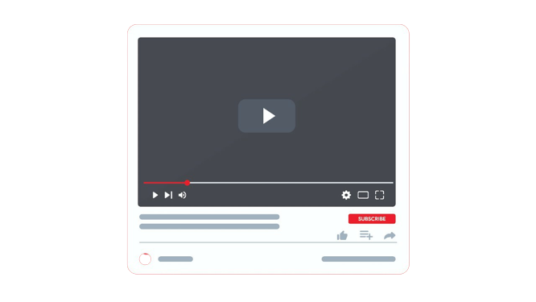
Why Cloud?

Slide 7

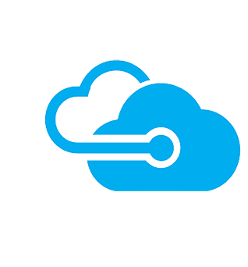

What is Cloud?
Just move your data to Cloud
Cloud with unlimited space
Local system with limited space

Slide 8
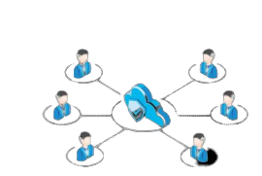
What is Cloud Computing?
Cloud Computing is:
Storing data/applications on remote servers.
Processing data/applications from servers.
Accessing data/applications via Internet.

Slide 9
Service Models

Slide 10
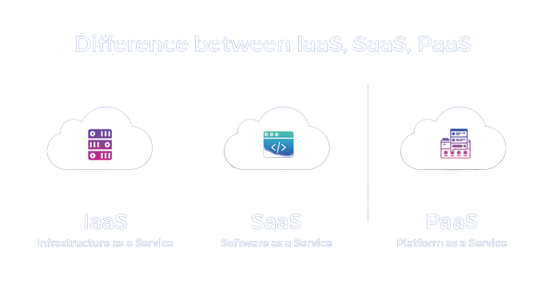
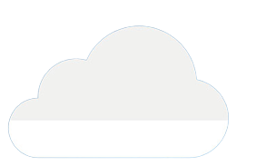
Service Models
IaaS
PaaS
SaaS

Slide 11
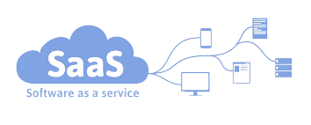
Service Models: SaaS?
Software as a Service
Cloud Provider leases applications or software which are owned by them to it’s client.

Slide 12
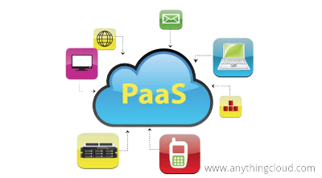
Service Models: PaaS?
No control over the underlying architecture including OS, storage, servers etc.

Slide 13
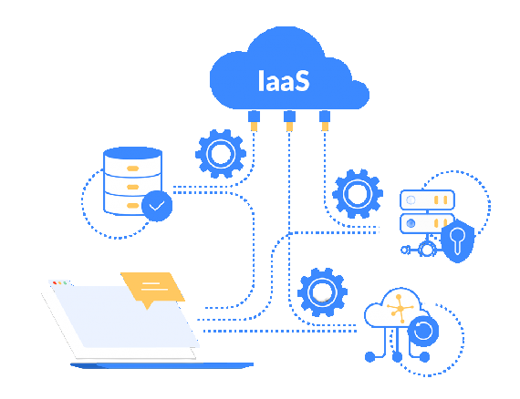
Service Models: IaaS?
Infrastructure as a Service
Provides virtualized computing resources over the internet.
No worries about the underlying physical machine.
Abstract the user from the physical machine.

Slide 14
Deployment Models

Slide 15
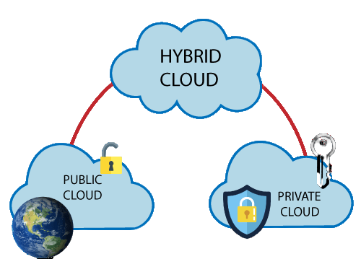
Deployment Models

Slide 16
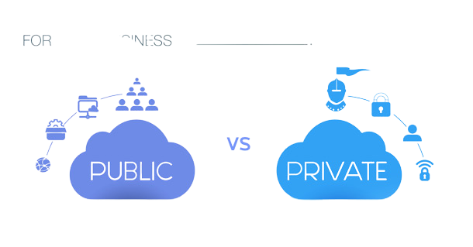
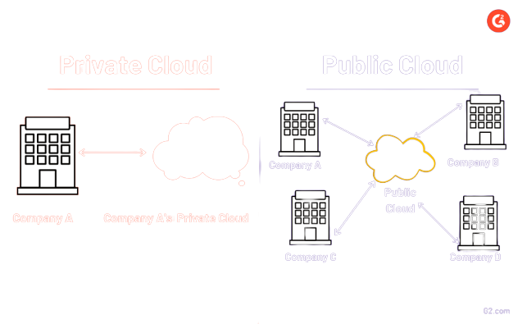
Deployment Models

Slide 17
Deployment Models

Slide 18
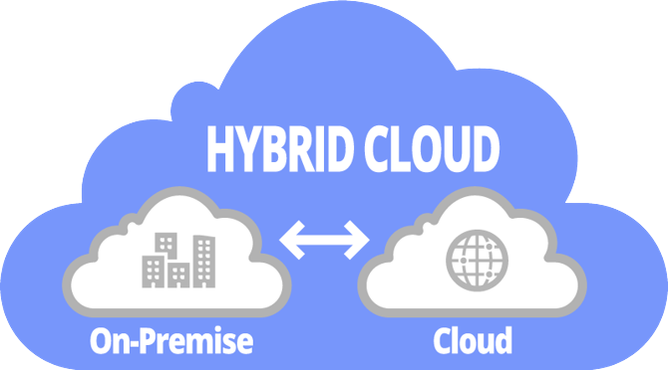
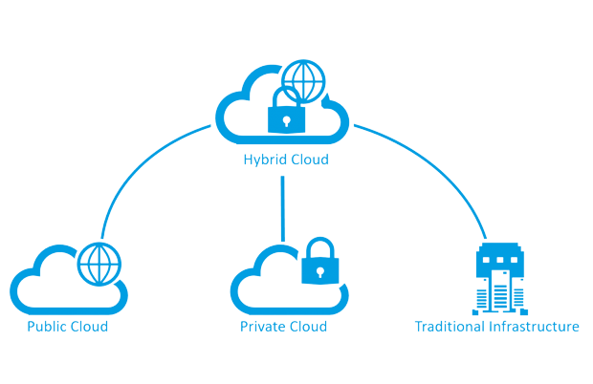
Deployment Models

Slide 19
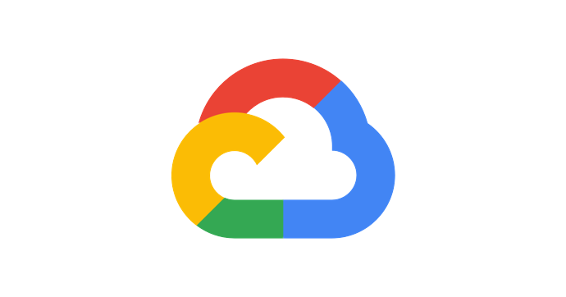




Cloud Providers
Amazon AWS
Google Cloud Provider
Digital Ocean
IBM Cloud

Slide 20
What is Microsoft Azure?

Slide 21

Use Case

Slide 22





Use Case Implementation
Database
Load Balancer
Userbase
File System
Servers

Slide 23


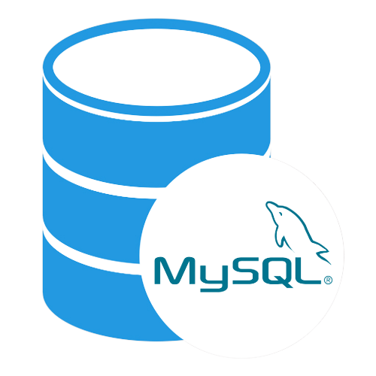

Implementation in Azure
App Service
Server
Azure Load Balancer & Auto-Scaling
Load Balancer
Database
MySQL Database
File System
Blob Storage

Slide 24
App Service

Slide 25


Compute Domain
Virtual Machine
App Service
Functions

Slide 26
Blob Storage

Slide 27


Storage Domain
Blob Storage
Queue Storage
Backup

Slide 28
MySQL for Azure

Slide 29
Auto-Scaling & Load Balancing
Auto-Scaling is used to automatically scale-up and scale-down according to needs, Load Balancer is used to equally distribute the incoming data to the number of servers running currently.

Slide 30
How to launch these services on Azure?

Slide 31
Thank you!
Do you have any questions?

